Slide 1

Pearce Creek DMCF Baseline Exterior Monitoring
Spring 2017 Results
Pearce Creek Implementation Committee
February 16, 2018

Slide 2
Project Overview
Objective: Collect data from monitoring locations to establish baseline conditions that will be used to monitor environmental conditions after dredged material placement starts
Previous sampling events were conducted in Fall 2015, Spring 2016, and Fall 2016
Testing program included:
  Surface water quality
  Sediment chemistry – testing of target chemicals
  Sediment bioassays – 10-day tests that evaluate organism survival
  Benthic community – Identification of bottom-dwelling organisms, including number of species (diversity) and number of organisms (abundance)

Slide 3
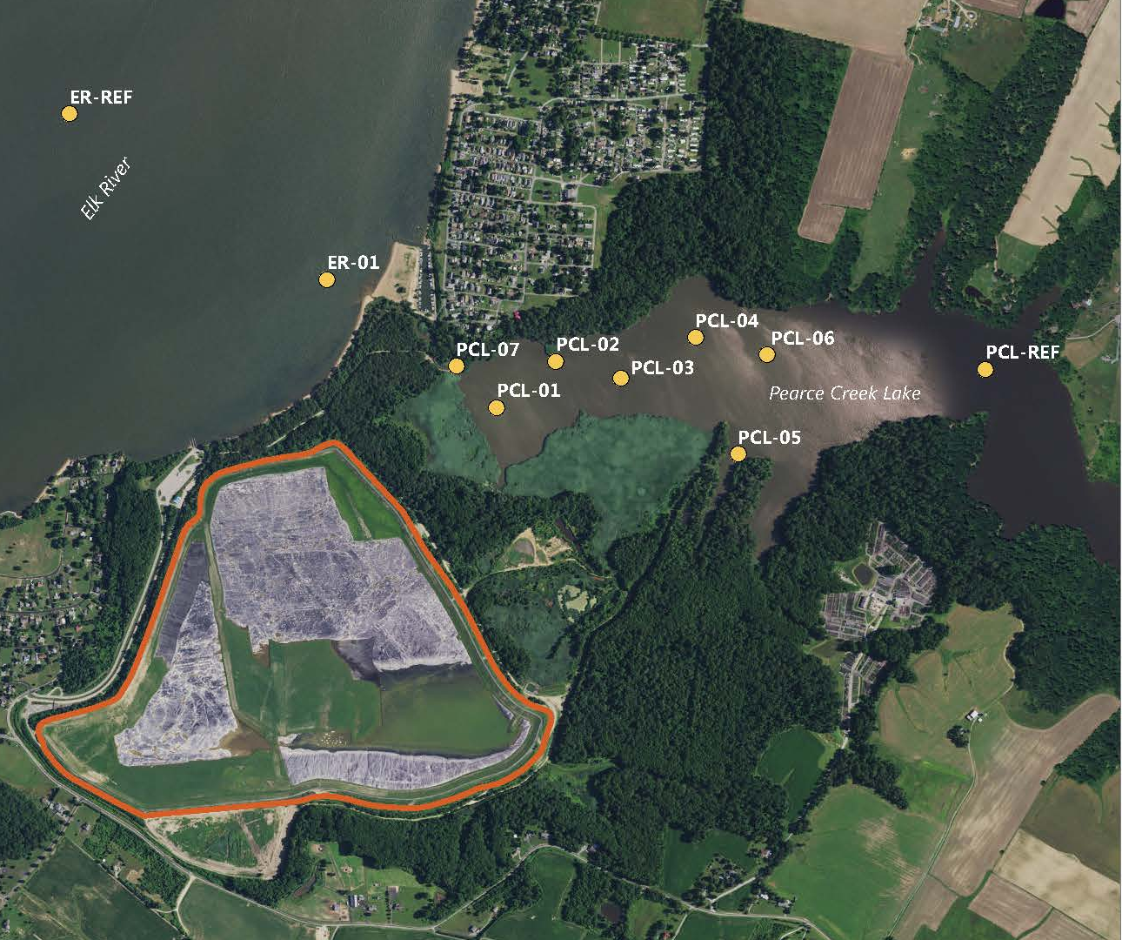
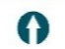
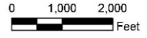
Sampling Overview – Spring 2017
10 Sampling Locations:
7 Pearce Creek Lake monitoring locations
1 Pearce Creek Lake reference site
1 Elk River monitoring location
1 Elk River reference site
Elk River Connecting Channel
Pearce Creek Dredged Material Containment Facility
  Reference sites represent areas that are outside of the influence of the DMCF

Slide 4
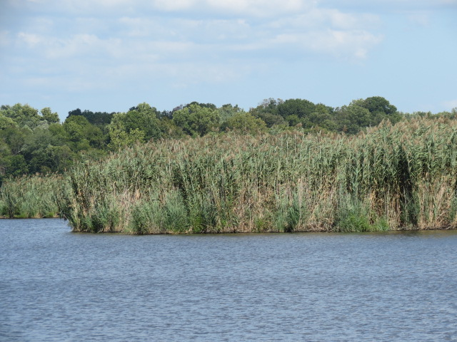
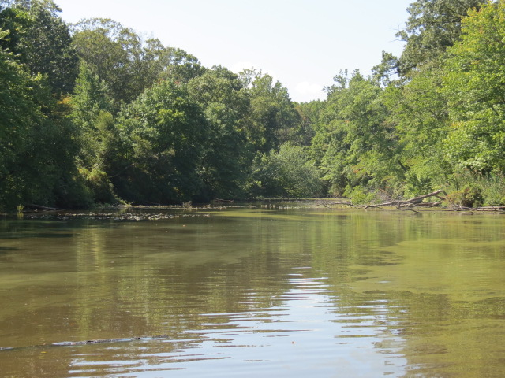
Surface Water Results
Turbidity
  Highly variable at Pearce Creek Lake locations because of natural factors (i.e., bank erosion, algae, and stormwater runoff)
  Elevated turbidity observed at locations PCL-01(38 NTU) and PCL-05 (36 NTU), compared to the reference site (24 NTU)
Chemical Testing
  Low concentrations overall; generally consistent with results from previous sampling events
  None of the samples exceeded water quality criteria
Location PCL-01
Location PCL-05
Notes:
Pearce Creek is freshwater
NTU is the unit used to measure turbidity – its based on the quantity of light that can pass through the water column, so it includes all suspended particles that impact water clarity, including sediment and biological factors (such as algae)
Turbidity in this sampling event was, on the whole, lower compared to previous events (typically see ranges from 30 to 60 NTU)
Clarification regarding “We don’t observe any increases or decreases compared to what would be expected”: The populations are naturally variable and that the changes from season to season are within the variability that would be expected – ie, there are no extreme increases or decreases and the changes are not correlated to variability in any other natural conditions.

Slide 5

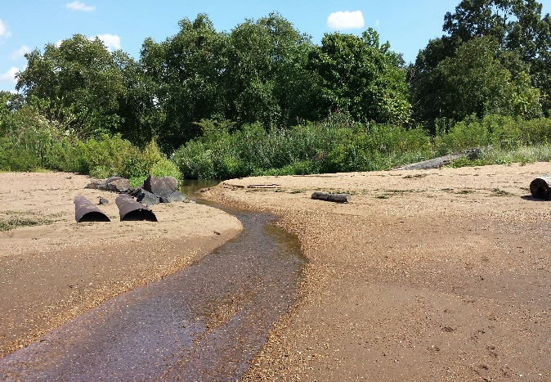
Sediment Results
Sediment Type
  Pearce Creek Lake sediment comprised of silts and clays, with some sand at PCL-07
  Elk River monitoring location and reference location were comprised of silty clays, with a lot of shell material
Nutrients and Metals
  Nutrient concentrations naturally variable at all locations
  Overall, concentrations of metals were below screening values at both the Pearce Creek Lake and Elk River monitoring and reference locations
Elk River Connecting Channel – Elk River
Outlet at High Tide
Elk River Connecting Channel – Elk River
Outlet at Low Tide

Slide 6
Sediment Data Analysis
Results of chemical testing were compared to freshwater sediment guidelines
  Derived by scientific community based on actual sediment concentrations
  Each chemical has two values:
    A threshold effect concentration (TEC)
    A probable effect concentration (PEC)
Below TEC
No effect on aquatic organisms
Between TEC and PEC
Potential for effect on aquatic organisms
Above PEC
Probable effect on aquatic organisms
TEC
PEC
    An “effect” means that an organism’s behavior is impacted, such as a slow down of organism growth rate
    “Effects” do not indicate mortality

Slide 7
Sediment Chemical Screening
  Results are consistent with the Fall 2015, Spring 2016, and Fall 2016 data
Pearce Creek Lake
  Monitoring Locations
    5 metals between the TEC and PEC
    Nickel exceeded the PEC
      Reference Site
        3 metals were between the TEC and the PEC
        Nickel exceeded the PEC
Elk River
  Monitoring Location
    No metals exceeded the TEC
  Reference Site
    6 metals were between the TEC and PEC
    2 metals (nickel and zinc) exceeded the PEC
Nickel concentrations are generally consistent with sediment in the upper reaches of the Chesapeake Bay
Notes:
PCL monitoring: arsenic, cadmium, copper, lead, zinc
PCL reference: arsenic, cadmium, zinc
ER monitoring:
ER reference TEC<x<PEC: arsenic, cadmium, chromium, copper, lead, mercury
ER reference >PEC: nickel and zinc

Slide 8
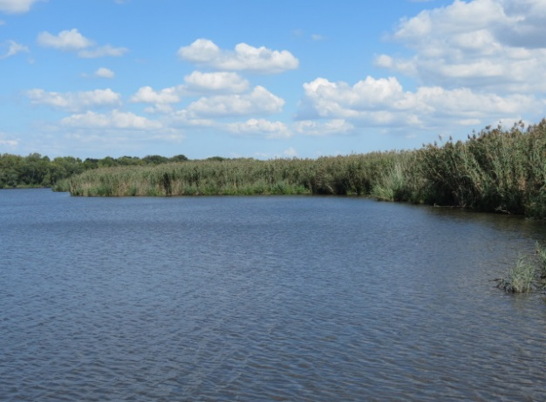

Benthic Bioassay Results
10-day whole sediment toxicity testing using Hyallela azteca : freshwater amphipod (laboratory cultured)
Compared results for each location to reference site
Results
  Survival high for the Pearce Creek Lake and Elk River sediments
  Sediments support benthic organisms
  Results are consistent with the Fall 2015, Spring 2016, and Fall 2016 data

Slide 9
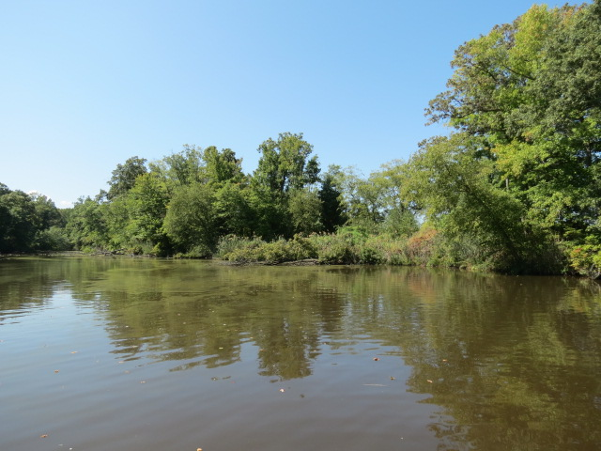
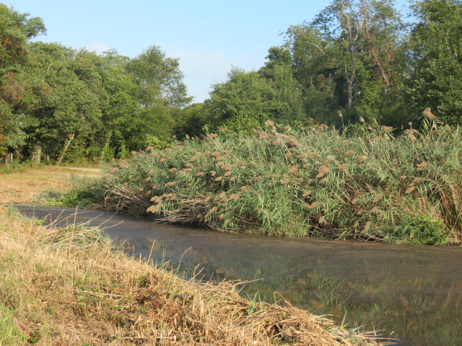
Benthic Community Results
Pearce Creek Lake and Elk River
  Abundance is highly variable at each location → there does not appear to be a consistent trend within this dataset
  Do not observe consistent seasonal trend between the Spring and Fall samples
  Generally, the highest abundance was in the Fall 2015 samples
Notes:
Based on the diversity indices, these communities are consistent with natural populations – we don’t observe any significant increases or decreases compared to what would be expected. And while there is variability from year-to-year, there are no obvious trends (not even a pronounced seasonality).
Clarification regarding “We don’t observe any increases or decreases compared to what would be expected”: The populations are naturally variable and that the changes from season to season are within the variability that would be expected – ie, there are no extreme increases or decreases and the changes are not correlated to variability in any other natural conditions.

Slide 10
Elk River - Beach Sampling

Slide 11
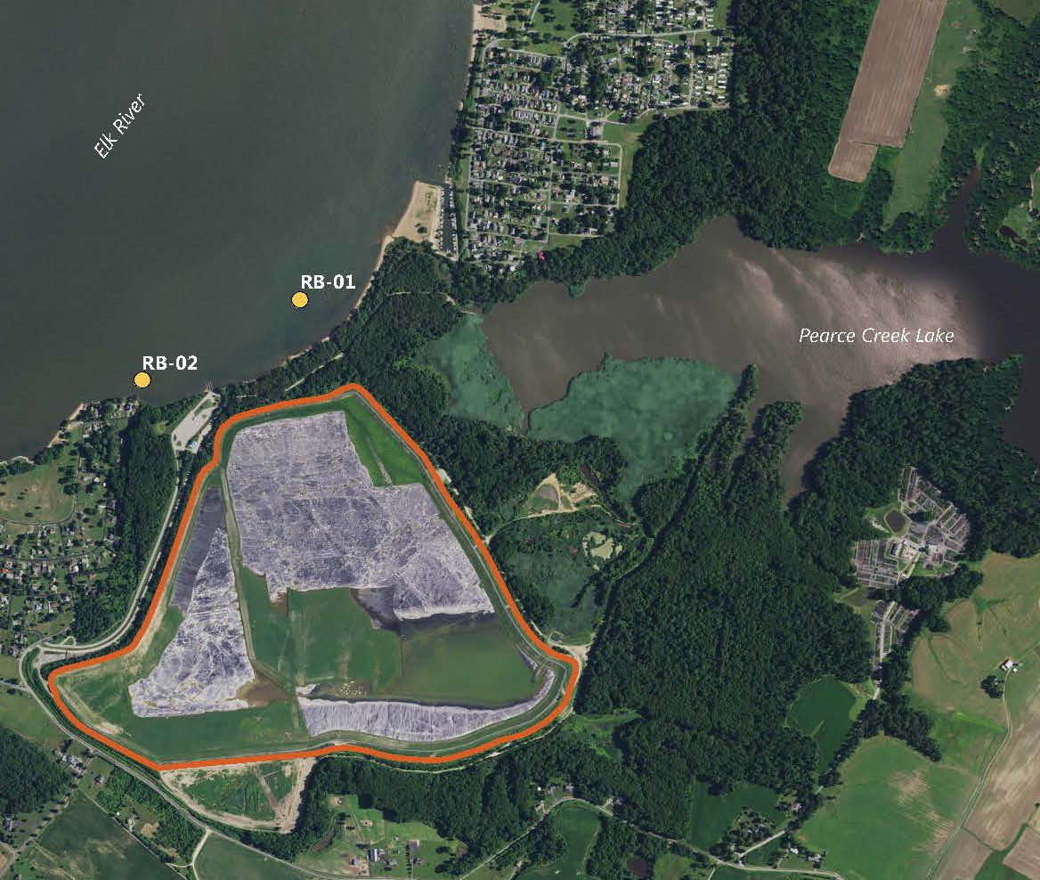
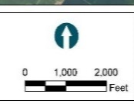

Sampling Overview – Spring 2016
  Samples collected in nearshore areas close to beach areas in the Elk River
  Added at the request of citizens
  Evaluated independently from the baseline exterior monitoring data
  Included same testing program
    Sediment
    Water quality
    Benthic community
    Benthic bioassays (one location only)
Elk River Connecting Channel
Pearce Creek Dredged Material Containment Facility

Slide 12
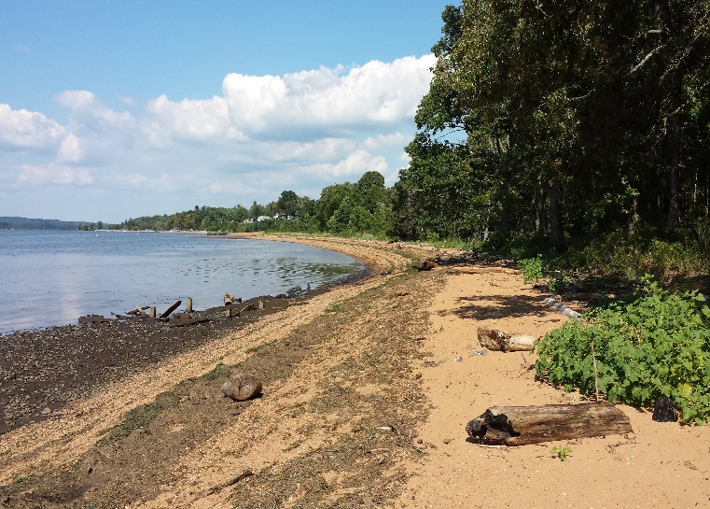

Surface Water Results
Locations were classified as freshwater – no measurable salinity
  Previous events were classified as oligohaline (salinity of 0.5 to 5 ppt)
Turbidity was low (14 and 16 NTUs)
Chemical Testing
  Concentrations are very low
  No water criteria exceedances; well below water quality criteria
  Consistent with concentrations observed in previous sampling events
Notes:
Mention that the freshwater inputs are likely a result of recent rainfall – slight shifts in salinity are common in these areas
Turbidity limits are 50 NTU, so for comparison these levels are low relative to regulatory limits.

Slide 13

Sediment Results
Sediment Type
  Location 1 was mostly sand with some shell fragments
  Location 2 was primarily sand
Nutrients and Metals
  Nutrient concentrations naturally variable
  Metal concentrations generally low and well below the sediment quality criteria
  None of the metals exceeded TEC values
  Results consistent with Spring 2016 and Fall 2016 data
Notes:
We did not sample these beach locations in Fall 2015 – they were not added to the program until Spring 2016.

Slide 14
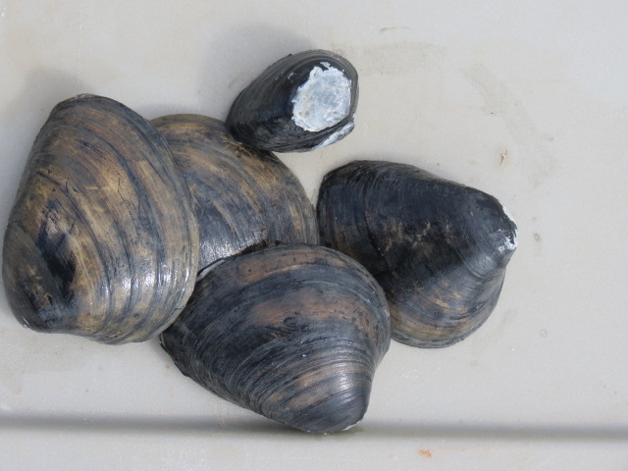
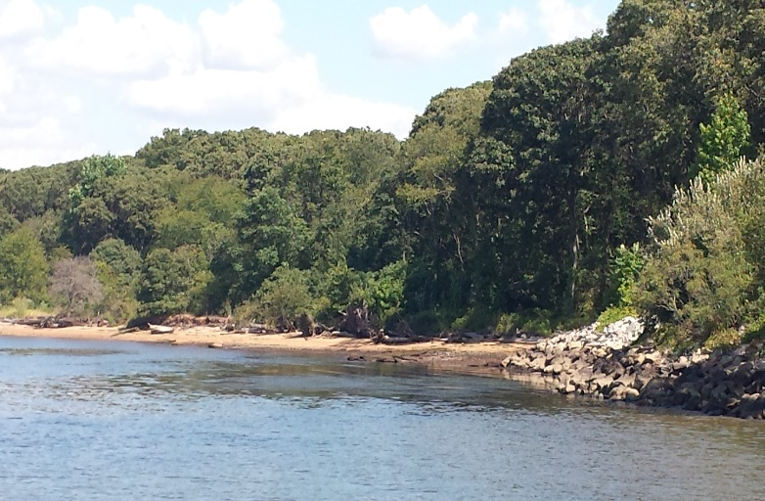
Benthic Community and Bioassay Results
Benthic Community
  Higher abundance compared to Elk River monitoring location
  Consistent with the results of previous sampling events
Benthic Bioassays
  Location 1 was 97 percent sand (76% more than in Spring 2016 event), but bioassay was conducted to be consistent with previous events
  Location 1 had high survival, therefore the sediment is not toxic
  Location 2 was 87 percent sand and gravel, so no bioassay sample collected
Notes:
Based on the diversity indices, these communities are consistent with natural populations – we don’t observe any significant increases or decreases compared to what would be expected. And while there is variability from year-to-year, there are no obvious trends (not even a pronounced seasonality).

Slide 15
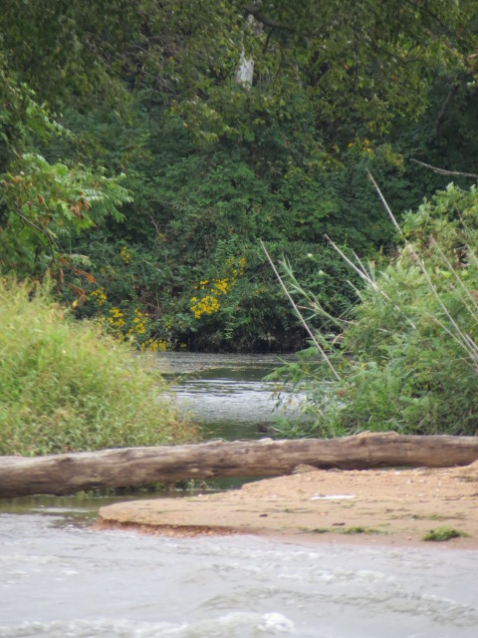
Elk River - Beach Sampling Schedule
This was the third round of sampling at these locations
These data establish the “existing” condition for water, sediment, and benthic community
Data will be used to evaluate if there are any changes to the nearshore Elk River environmental conditions over time

Slide 16
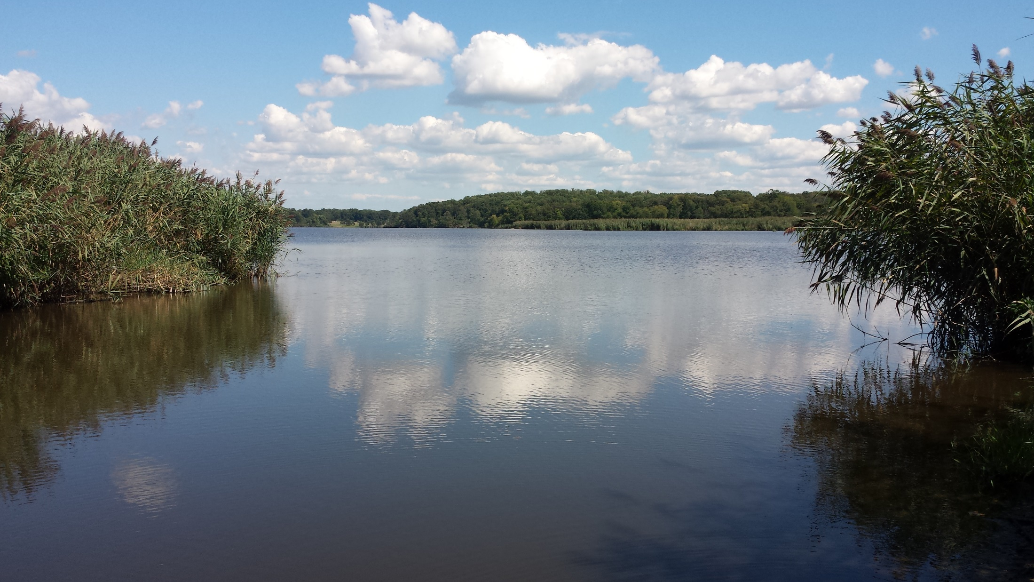
Questions/Discussion

